Slide 1
Savify
A file based version tracking utility
CMPE 272
Yatish Koul SID: 016695328
San Jose State University

Slide 2
Outline:
Introduction
Literature Review
Background Work
System Model
System Description
Design Approach Algorithm and Pseudocode
Challenges and Benefits
Future Scope
Conclusion

Slide 3
Savify: A File Monitoring Tool
- Utilizes Git for tracking changes in files, each in a separate orphan branch.
Streamlining Orphan Branch Creation
- Simplifies the creation of orphan branches from an empty repository.
- Achieves this through patch files merged with Git HEAD.
Accessible Git Abstraction Layer
- Makes Git features user-friendly, especially for those with limited command line experience.
Efficient Management of File Changes
- Maintains a dedicated database to monitor modifications.
- Restores files individually in orphan branches.
- Addresses complexities and merge conflict issues inherent in Git-native approaches, especially in large projects.
Introduction:

Slide 4
Evolution of Version Control Systems (VCS)
- Key role in managing changes in digital assets.
Centralized Version Control Systems (CVCS)
- Example: Subversion (SVN).
- Centralized versioning in a single location.
- Limitations: Restricted collaboration and required constant connectivity.
Emergence of Distributed Version Control Systems (DVCS)
- Example: Git.
- Enabled offline work and distributed collaboration.
- Introduced complexities, especially for users not familiar with command-line interfaces.
Challenges with Git
- Steep learning curve, particularly in branch management and merge conflict resolution.
Graphical User Interfaces (GUIs) for Git
- Examples: GitKraken, SourceTree.
- Aim to simplify Git usage but still leave room for improvement.
Market Demand for Intuitive VCS
- Studies by Smith et al. (2018) and Johnson (2021) highlight developer demand for a user-friendly, file-based VCS interface.
Literature Review:

Slide 5
Importance of Version Control in Software Development
- Essential for logging and managing codebase changes.
Git: A Game-Changer in Version Control
- Noted for its decentralized system and branch management.
Challenges with Git's Intricate Nature
- Difficulty in managing evolution of individual files and their detailed histories.
- Assumes impact on the entire project for any file change.
Current Version Control Practices
- Focus on project-wide updates and versioning.
- Reverting and tracking specific file alterations can be tedious.
Limitations in Handling File-Level Changes
- Often requires reviewing the entire project's change log.
- Makeshift solutions like creating separate branches for each change can lead to disorganization.
Background Work:

Slide 6
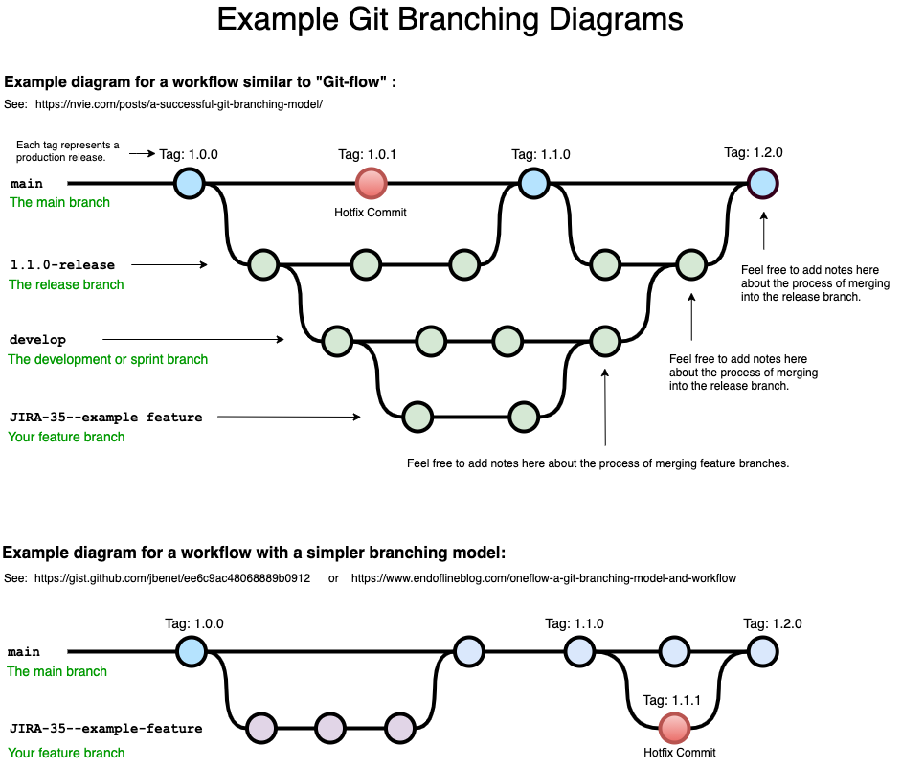
System Model:
Current Approach
main: This is the main branch where the source code reflects the production-ready state.
1.1.0-release: Known as the release branch, it's used for preparing a new production release. It allows for minor bug fixes and preparing metadata for a release.
develop: The development or sprint branch is where developers merge feature branches to test all changes together. This branch contains the latest delivered development changes for the next release.
JIRA-35--example feature: This represents a feature branch, typically used for developing new features or changes to the codebase. Once the feature is complete, it is merged back into the develop branch.
Tag: These are specific points in the repository's history marked as significant, usually as release points (e.g., 1.0.0, 1.0.1, 1.1.0, 1.2.0).
Hotfix Commit: A commit made directly to the main branch to fix an urgent issue in the production environment. After the hotfix, the changes are merged back into both the main and develop branches to ensure that the fix is included in future releases.
The lines connecting the branches represent the flow of changes as they are merged from one branch to another. This approach allows for development to proceed on features and fixes without interfering with the production code until they are ready to be released.

Slide 7
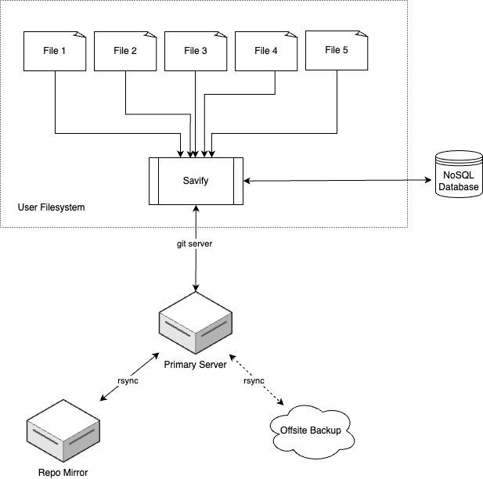
System Description:
File 1 to File 5: These represent individual files on a user's filesystem that are being tracked for changes.
User Filesystem: This is the local storage area on a user's computer where files are stored.
Savify: It acts as an intermediary between the user's filesystem and the Git server. Savify monitors changes to the files and communicates with the Git server to record these changes. It likely also interacts with a NoSQL database to store metadata or additional information about the file changes.
Git Server: A remote server where the Git repository is hosted. Savify pushes the changes to this server, ensuring that the version control system is updated with the latest versions of the files.
NoSQL Database: A type of database designed to store, retrieve, and manage document-oriented information. The NoSQL database here is probably used to store non-relational data, such as file change logs or other metadata that doesn't fit into a traditional table-based structure.
Primary Server: The central server in the architecture that likely serves a crucial role in managing the application's operations, possibly hosting the main application logic, APIs, and other core services.
Repo Mirror: This is a redundant copy of the Git repository. It is synchronized with the primary Git server via 'rsync', a utility for efficiently transferring and synchronizing files across computer systems.
Offsite Backup: A backup storage solution located in a different physical location from the primary server to ensure data integrity and availability in case of system failure, data corruption, or a disaster at the primary site. The offsite backup is also updated using 'rsync', which indicates that it's an exact copy of the data stored on the primary server.
This setup aims to provide robust file version control and backup strategy by combining Git's versioning capabilities with Savify's file monitoring and system backups to ensure data safety and consistency.

Slide 8
Demo

Slide 9
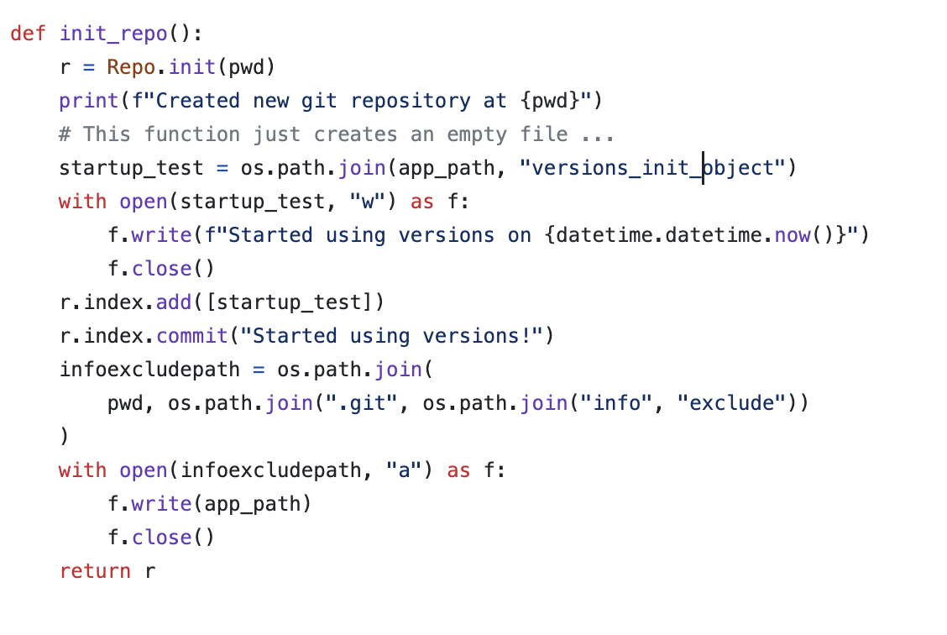
Design and Algorithms:
Initialize New Git Repository
- Initializes a new Git repository in a specified directory.
Create Initial Commit
- Generates an initial commit with a timestamped message.
Configure Git Exclusions
- Sets up Git to exclude certain files or directories from tracking.
Return Repository Object
- Returns the initialized Git repository object for further operations.

Slide 10
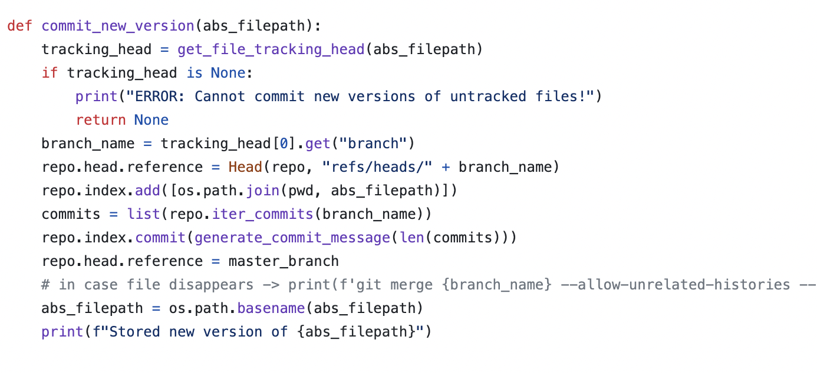
`commit_new_version` Function Overview
- Designed to commit new file versions to a Git repository.
File Tracking Verification
- Checks if the file is tracked in the repository; if not, raises an error.
Branch Identification and Switching
- Determines the branch associated with the file.
- Switches the active branch to the identified branch.
File Staging and Committing
- Stages the file for commit.
- Auto-generates a commit message based on the commit count in the branch.
- Executes the commit of the changes.
Master Branch Reset
- After committing, resets the active branch back to the master branch.
Confirmation Message
- Outputs a confirmation of the successful new version storage.
Merge Operation Note
- Includes a comment on a potential merge operation.
- Actual merge command is provided but commented out.

Slide 11
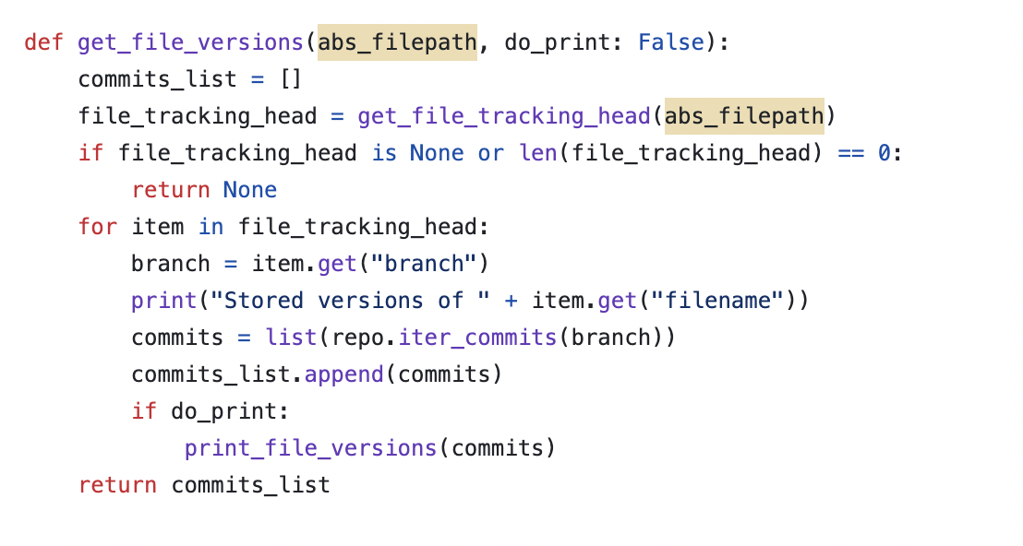
Overview of `get_file_versions` Function in Python
- Retrieves version history of a specified file within a version control repository.
Initial Check for Tracking Information
- Confirms the existence of tracking data for the file.
- Returns `None` if no tracking data is available.
Iteration Over Tracked Branches
- Goes through each branch where the file is tracked.
Commit Retrieval and Storage
- Fetches the commit list for the file from each branch.
- Accumulates commits in a list.
Optional Printing of Commits
- If `do_print` parameter is set, prints commit history for each file version.
Function Output
- Returns a list of commits representing the file's version history from all branches it is tracked on.

Slide 12
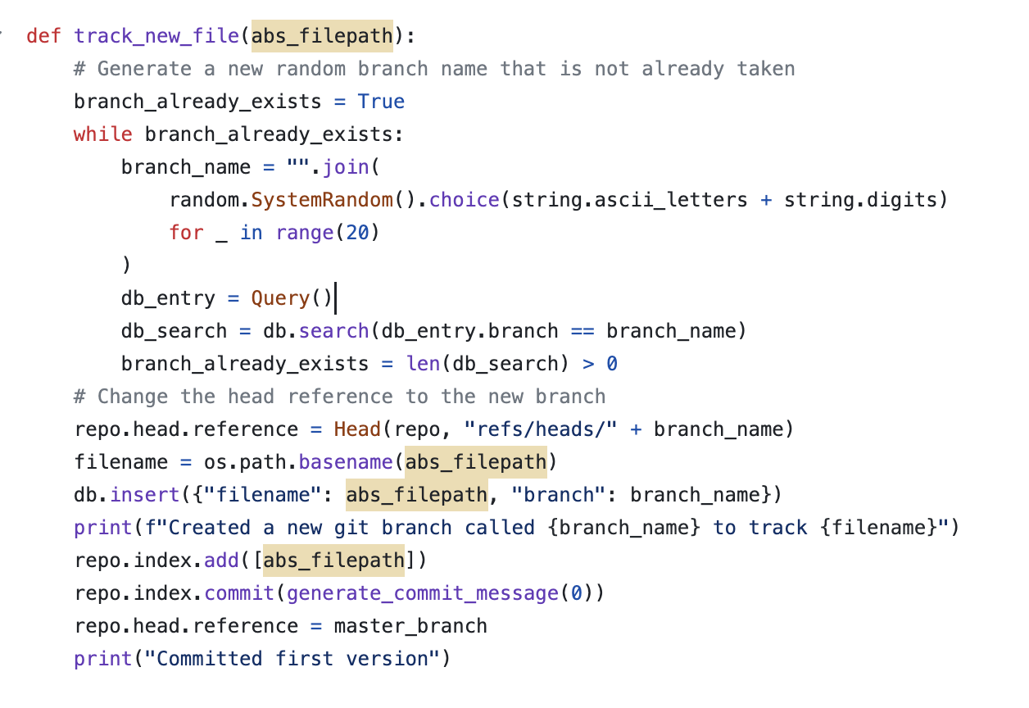
Functionality of `track_new_file
- Creates a unique branch in a Git repository specifically for a new file.
Branch Name Generation
- Generates a random branch name and confirms it's not already used in the database.
Branch Initialization and HEAD Setting - Sets the repository's HEAD to the new branch after ensuring its uniqueness.
Database Insertion of Tracking Details
- Inserts file tracking details into the database upon branch creation.
File Addition and Commit
- Adds the file to the index, commits it with an initial message.
Finalization and Return to Master Branch
- Resets the HEAD to the master branch post-commit.
- Outputs a confirmation that the first version of the file has been committed.

Slide 13
Challenges:
Git's foundational assumption: Changes in a single file affect the entire project.
Lack of file-specific version control: Git primarily focuses on versioning the entire project directory.
Reverting changes: Git's default behavior makes it challenging to revert changes in a specific file without affecting the entire project.
Commit-based approach: Git reverts files based on commits, not individual file changes.
Limited file-level history: To access previous versions of a single file, you must navigate through the commit history of the entire project.
Granular control challenge: Git lacks built-in mechanisms for granular control over individual file revisions.
Workarounds: Git users often resort to workarounds like branching or using third-party tools to manage file-specific versioning.

Slide 14
Benefits:
Efficient File Tracking: Savify simplifies the process of keeping track of multiple individual and unrelated files within the same directory.
Granular Version Control: It enables you to perform file-specific version control, allowing you to focus on individual files without affecting the entire directory.
Precise Reversions: Savify empowers you to revert changes in a file with precision. You can easily roll back changes in a specific file without impacting other files in the directory.
Enhanced Tracking: With Savify, you can effortlessly monitor changes to a file and its various versions, providing you with a comprehensive history of file modifications.
Streamlined Collaboration: Savify's capabilities facilitate collaborative work by making it easier to manage and track changes within a shared directory without disrupting the workflow.

Slide 15
Future Scope:
Integrated UI Development: The project's scope extends to the creation and collaboration of a user interface (UI) alongside the codebase. This integration enhances efficiency and simplifies development.
Cross-Platform Availability: The project offers the capability to package the application for multiple platforms, ensuring a broader reach. Supported platforms include:
Linux: Package distribution via APT/RPM repositories, catering to Linux users.
MacOS: Inclusion in the HomeBrew package manager, providing accessibility to macOS users.
Windows: Availability through the Win-Get repository, making the application accessible to Windows users.

Slide 16
Thank you for listening

